Slide 1

Wound Healing

Slide 2

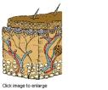

Skin: structure and function
Largest organ of the body
Primary function is protective
Composed of several layers
  Outer Epidermis
  Dermis, containing the capillary network
  Subcutaneous layer (hypodermis, adipose layer)

Slide 3

Skin: structure and function
Thickness varies from a thin membrane at internal flexures (e.g. elbows), to thicker at the soles of the feet which bear considerable pressures
Hair follicles, sebaceous glands, and sweat glands pass through the epidermis, but arise from the dermal layer

Slide 4
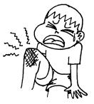
Classifying wounds
A wound can be
defined as:
“A cut or break in
the continuity of
any tissue, caused
by injury or
operation”
(Baillière’s 23rd Ed)
Wounds can be classified
according to their nature:
Abrasion
Contusion
Incision
Laceration
Open
Penetrating
Puncture
Septic etc……………

Slide 5
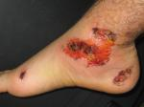
Classifying wounds
Wounds may be classified according to the
number of skin layers involved:
Superficial
  Involves only the epidermis
Partial Thickness
  Involves the epidermis and the dermis
Full Thickness
  Involves the epidermis, dermis, fat, fascia and exposes bone

Slide 6
Classification
Clean - (non traumatic)
Clean contaminated
Contaminated
Dirty

Slide 7
The ways in which wounds heal
Three basic classifications exist:
  Healing by primary intention
  Two opposed surfaces of a clean, incised wound
  (no significant degree of tissue loss) are held together.
  Healing takes place from the internal layers outwards
  Healing by secondary Intention
  If there is significant tissue loss in the formation of the
  wound, healing will begin by the production of
  granulation tissue wound base and walls.
  Delayed primary healing
If there is high infection risk – patient is given antibiotics
and closure is delayed for a few days e.g. bites

Slide 8
Wound healing
All wounds heal following a a specific sequence of phases which may overlap
The process of wound healing depends on the type of tissue which has been damaged and the nature of tissue disruption
The phases are:
  Inflammatory phase
  Proliferative phase
  Remodelling or maturation phase

Slide 9
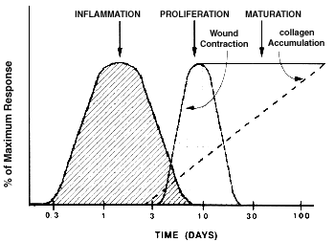
Schematic Diagram of the Phases of Wound Healing

Slide 10

The healing process
Day 0 – 5
The healing response starts at the moment of injury – the clotting cascade is initiated
This is a protective tissue response to stem blood loss
The inflammatory phase is characterised by heat, swelling, redness, pain and loss of function at the wound site
Early (haemostasis)
Late (phagocytosis)
This phase is short lived in the absence of infection or contamination

Slide 11
Granulation
Day 3 – 14
Characterised by the formation of granulation tissue in the wound
Granulation tissue consists of a combination of cellular elements including:
    Fibroblasts, inflammatory cells, new capillaries embedded in a loose extra-cellular collagen matrix, fibronectin and hyularonic acid

Slide 12
Angiogenesis
Collagen first detected at day 3 and rapidly increases for approx. 3 weeks, then more gradually for the next 3 months
Fibroplasia (fibroblast proliferation and synthetic activity) continues in parallel with re-vascularisation
Endothelial cells from the side of venules closest to the wound begin to migrate in response to angiogenic stimuli (angiogenesis) forming capillary buds, then loops

Slide 13
Epithelialisation
The epidermis immediately adjacent to the wound edge begins to thicken within 24hrs after injury
In approximated incised wounds re-
epithelialisation is usually complete within 48hrs.

Slide 14
Maturation
Can last up to 2 years
New collagen forms, changing the shape of the wound and increasing the tensile strength
Scar tissue, however is only ever approx. 50-80% as strong as the original tissue
During the remodelling process there is a gradual reduction in cellularity and vascularity of the reparative tissue

Slide 15
Contraction
Only undesirable where it leads to unacceptable tissue distortion and an unsatisfactory cosmetic result
Wound contraction usually begins from day 5 and is complete at approx. day 12 - 15

Slide 16
Moist wound healing
Basic concept is that the presence of exudate will provide an environment that stimulates healing
Exudate contains:
    Lysosomal enzymes, WBC’s, Lymphokines, growth factors……..
There are clinical studies which have shown that wounds maintained in a moist environment have lower infection rates and heal more quickly

Slide 17
Factors affecting healing
Immune status
Blood glucose levels (impaired white cell function)
Hydration (slows metabolism)
Nutrition
Blood albumin levels (‘building blocks’ for repair, colloid osmotic pressure - oedema)
Oxygen and vascular supply
Pain (causes vasoconstriction)
Corticosteroids (depress immune function)

Slide 18
Practical considerations
The cause of the wound
Underlying disease processes
  Current health status
Medication
Acute or chronic?
Attitude to the wound
Availability of care

Slide 19
Healing requirements
Identification of the hindrance to healing
Adequate nutritional status
Adequate perfusion and oxygenation
High quality, research-based patient and wound management
Correction of the underlying cause of the problem
Disease management

Slide 20
Wound assessment
Signs of infection
Lab tests:
TcPO₂
Size, depth & location
Odour or exudate
WOUND ASSESSMENT
Wound bed:
necrosis
granulation
Wound edge
Surrounding skin: colour, moisture,

Slide 21
Classifying wounds
Grading by tissue Involvement
Grade III – full thickness skin loss involving damage or necrosis of subcutaneous tissue that may extend down to but not through underlying fascia
Grade IV – extensive destruction, tissue necrosis or damage to muscle, bone or supporting structures with or without full thickness skin loss.
EPUAP 1999
Grade I – non-blanchable erythema
of intact skin. Discoloration of the
skin, warmth, oedema, induration
or hardness may also be used as
indicators in people with dark skin.
Grade II – partial-thickness skin loss
involving epidermis, dermis or both.
The ulcer is superficial and presents
clinically as an abrasion or blister.

Slide 22
Clinical appearance
Describes the type of material present
In the base of the wound:
  Slough (yellow)
  Necrotic tissue (black)
  Infected tissue (green)
  Granulating tissue (red)
  Epithelialising (pink)

Slide 23
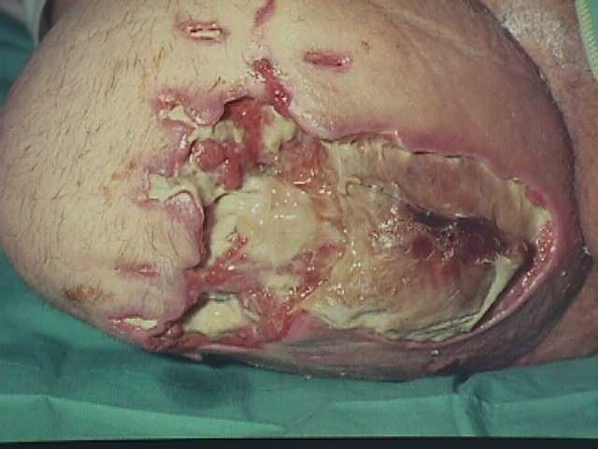
Sloughy wound
Aim: to liquefy slough and aid its removal
Dead cells accumulated in
exudate
Prepare wound bed for
granulation
Assess wound depth and
exudate levels
Hydrogels, hydrocolloids,
alginates and hydrofibre
dressings

Slide 24
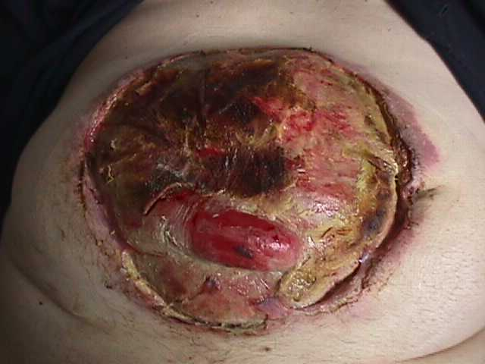
Necrotic wound
Aims: to debride and remove eschar
Provide the right
environment for autolysis
Assess wound depth and
exudate levels
Hydrogels, hydrocolloid
dressings

Slide 25
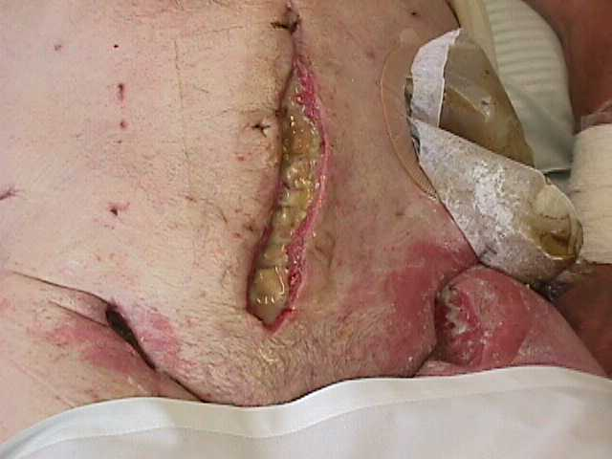
Infected wound
Aims: reduce exudate,
odour and promote
healing
Clinical signs of infection
Swab wound – systemic antibiotics
Treat symptomatically: exudate and odour control
Change dressings daily

Slide 26
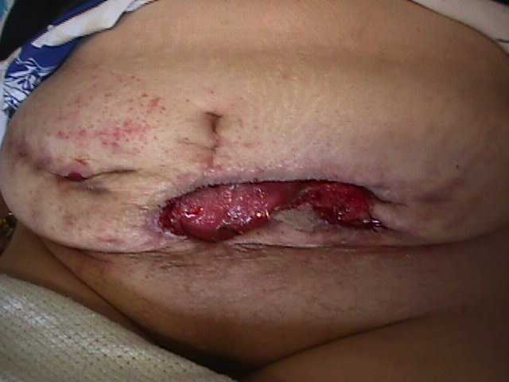
Granulating wound
Aims: support granulation, protect new tissue, keep moist
Assess depth and exudate levels
Moist wound surface – non-adherent dressing
Treat over-granulation
Hydrocolloids, foams, alginates

Slide 27
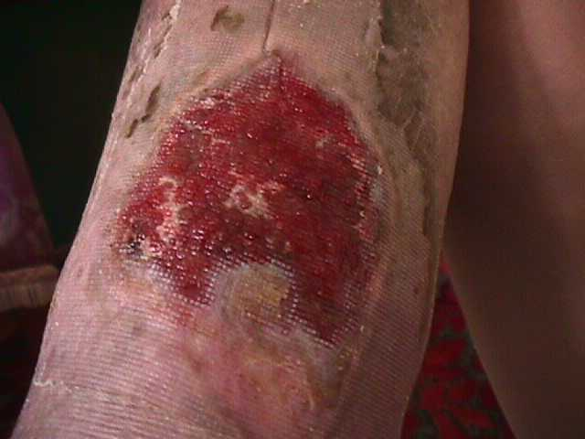
Epithelialising wound
Aims: to provide suitable conditions for re-surfacing
, films, hydrocolloids
Disturb as little as possible

Slide 28
Wound characteristics
The surrounding skin
Eczema
Psoriasis
Maceration/excoriation
due to exudate or
bowel contents
Self-inflicted damage
Exudate
Odour
Condition of tissue within the wound
Condition of the surrounding skin

Slide 29
Monitoring healing progress
Wound dimensions
Photography
Wound assessment
charts
Frequency of
assessment
Plan of care
Useful information
Other methods

Slide 30
Dressing choice
What is available?
How do we choose?
Does the patient have a say?
Do we consider cost?
Are choices restricted by a protocol?
How do we evaluate?

Slide 31
Dressing choice
The purpose of
dressings:
To aid debridement
To remove excess exudate
To control bleeding
To protect a wound
To support healing
The ideal dressing
A dressing that
creates the optimum
environment
Wound debridement
Wound cleansing
Alternative therapies

Slide 32
Dressing choice
Non-adherent wound contact materials
Films
Hydrogels
Hydrofibre dressings
Hydrocolloids
Foams
Alginates
Miscellaneous

Slide 33

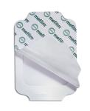
Dressing choice
Film dressings
Semi-permeable primary or secondary
dressings
Clear polyurethane coated with adhesive
Conformable, resistant to shear and tear
Do not absorb exudate
Examples: Tegaderm, Op-site.

Slide 34

Dressing choice
Hydrocolloids
Pectin, gelatin, carboxymethylcellulose and
elastomers
Environment for autolysis to debride sloughy or
necrotic wounds
Occlusive --> hypoxic environment to
encourage angiogenesis
Waterproof
Different presentations e.g. Urgotul

Slide 35

Dressing choice
Foam dressings
Advanced polymer technology
Non-adherent wound contact layer
Highly absorptive
Semi-permeable
Various types
Adhesive and non-adhesive

Slide 36
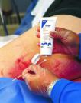
Dressing choice
Hydrogels
Sheets or gels
Starch and polyacrylamide (94% water)
Low exudate, shallow wounds
Re-hydrates necrotic tissue
Secondary dressing needed
May cause skin maceration

Slide 37
Dressing choice
Alginates
Seaweed dressings
Form a gel over the wound
Moderate to high exudate wounds
Easily removed
Can cause pain
Help to debride a wound
Different presentations

Slide 38

Debridement methods
Hydrogels
Hydrocolloids
Alginates
Hydrofibre dressings
Surgical
Wet to dry dressings
Whirlpool

Slide 39
Tissue Viability
Documenting wound care
Potential for litigation
Good staff communication
Continuity of care
To assess progress or deterioration
Should be factual not subjective
Wound assessment charts

Slide 40
Conclusion
Wound care is becoming more complex as the range of wounds increases
Correction of the underlying causative factors is essential
Key principles must be adhered to with regard to basic patient and wound assessment

Slide 41

Thank you

